Slide 1
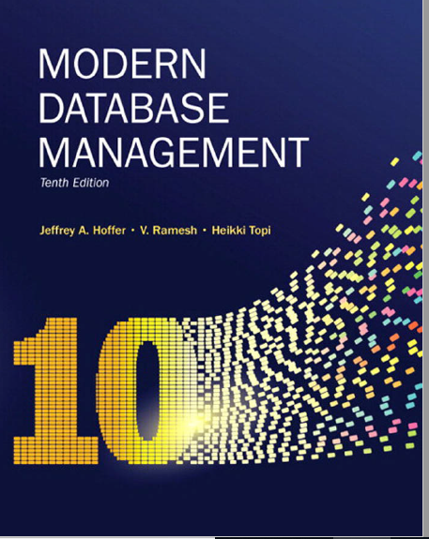
Chapter 1: The Database Environment and Development Process

Slide 2
Objectives
Define terms
Name limitations of conventional file processing
Explain advantages of databases
Identify costs and risks of databases
List components of database environment
Identify categories of database applications
Describe database system development life cycle
Explain roles of individuals
Explain the three-schema architecture for databases
Notes:
Define terms related to data and database
Name limitations of conventional file processing- which were the first forms of databases
Explain advantages of databases
Identify costs and risks of databases
List components of database environment
Identify categories of database applications
Describe database system development life cycle
Explain roles of individuals
Explain the three-schema architecture for databases

Slide 3
Definitions
Database: organized collection of logically related data
Data: sored representations of meaningful objects and events
Structured: numbers, text, dates
Unstructured: images, video, documents
Information: data processed to increase knowledge in the person using the data
Metadata: data that describes the properties and context of user data
Notes:
Database: organized collection of logically related data – key word is related data which implies it is a database. Why Logical, not physical: doesn’t it have to be in the same data center?
Data: stored representations of meaningful objects and events - e.g. social media store posts, pictures etc.
Structured: numbers, text, dates
Unstructured: images, video, documents
Information: data processed to increase knowledge in the person using the data. The difference between data and information is that information increases knowledge.
Metadata: data that describes the properties and context of user data – or simply data about the data.

Slide 4
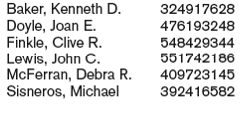
What is represented in the data below?
Notes:
Peoples name, Savings account number
Peoples name, Social security number!
Is this a record from department of revenue collection taxes, peoples name with SS#
Student names with ss#

Slide 5
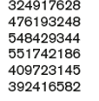

What do you see?
Notes:
Some numbers, and a number with decimal point
Could that be social security number and some sort of ranking
Could be account number and the amount
What is missing about the data to make it meaningful?

Slide 6
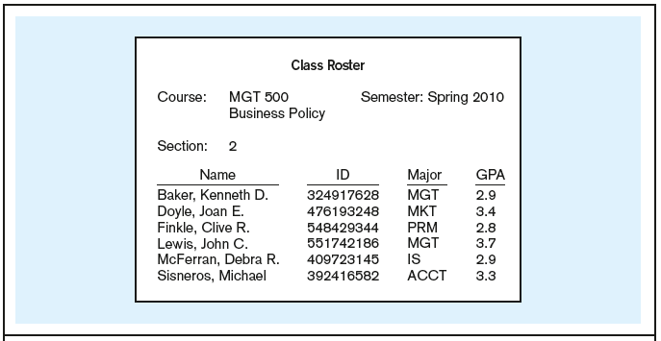
Figure 1-1a Data in context – converting data to Information
Context helps users understand data
Notes:
Data without context means nothing!
Only through context, one can understand the data.!
What metadata can you derive from this image?
Course: alpha numeric
Semester: alphanumeric
Section: numeric
Name: alphanumeric
GPA: decimal

Slide 7
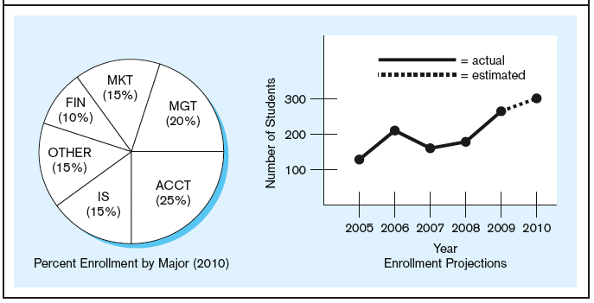
Figure 1-1b Summarized data
Graphical displays turn data into useful information that managers can use for decision making and interpretation

Slide 8
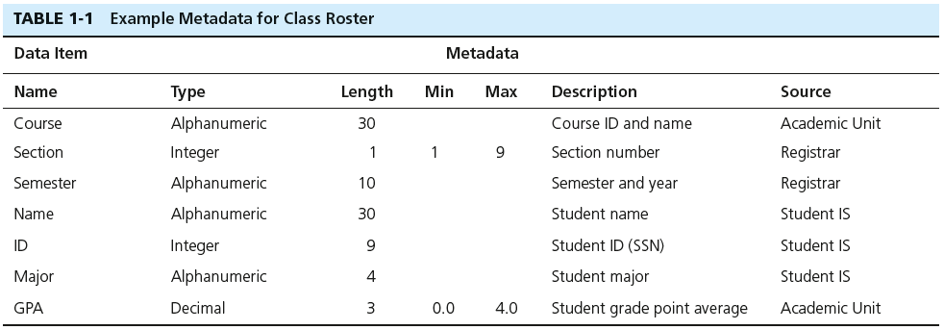
Descriptions of the properties or characteristics of the data, including data types, field sizes, allowable values, and data context
Notes:
Example of meta data – data about the data.

Slide 9
Question
A driver’s license bureau maintains a database of licensed drivers. State whether each of the following represents data or metadata. If it represents data, state whether it is structured or unstructured data. If it represents metadata, state whether it is a fact describing a property of data or a fact describing the context of data.
Driver’s name, address, and birth date
The fact that the driver’s name is a 30-character field
A photo image of the driver
The fact that birth date is stored using the column name Birth Date
An image of the driver’s fingerprint
The make and serial number of the scanning device that was used to scan the fingerprint
The resolution (in megapixels) of the camera that was used to photograph the driver
The fact that the driver’s birth date must precede today’s date by at least 16 years
A 10-second video clip in which the driver states his or her name
Notes:
Driver’s name, address, and birthdate: structured data
The fact that the driver’s name is a 30-character field: metadata; fact describing property
A photo image of the driver: unstructured data
The fact that birth data is stored in BirthDate: metadata
An image of the driver’s fingerprint: unstructured data
The make and serial number of the scanning device that was used to scan the fingerprint: structured data
The resolution (in megapixels) of the camera that was used to photograph the driver: metadata; fact describing context
The fact that the driver’s birth date must precede today’s date by at least 16 years: metadata; fact describing context
A 10-second video clip in which the driver states his or her name: unstructured data

Slide 10
Team Exercise
It is the year 1950. You are a COO of a national bank ( for savings and checking accounts) which operates across the country ( U.S) in all 50 states. Customers main complaint is the waiting time it takes for their records to be found after presenting their identification(account number, name, picture ID etc.). You are tasked to improve the process of storing and retrieving customer records. All records are stored on paper.
Describe how would you optimize customer records in a way that is most efficient for storage and retrieval?
Notes:
Checking and Savings account.
What type of data would you have stored. Transaction, money in and money out, customer info: name, address phone number

Slide 11
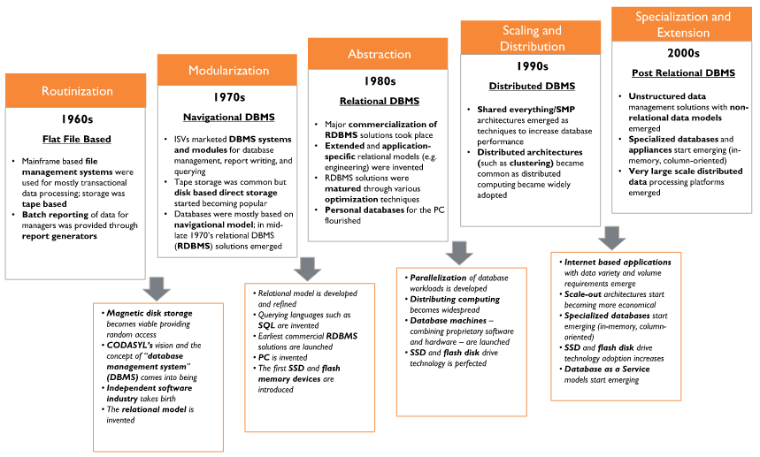
File Processing
source: google images
Notes:
The first applications to solve the problems you tried to solve with the bank is creating of software systems.
Instead of storing the data on the paper

Slide 12
File Processing
Earlier systems ( prior to late 80s ) used files to store data.
What are the disadvantages of file processing?

Slide 13
Disadvantages of File Processing
Program-Data Dependence
All programs maintain metadata for each file they use
Duplication of Data
Different systems/programs have separate copies of the same data
Limited Data Sharing
No centralized control of data
Lengthy Development Times
Programmers must design their own file formats
Excessive Program Maintenance
80% of information systems budget

Slide 14
Problems with Data Dependency
Each application programmer must maintain his/her own data
Each application program needs to include code for the metadata of each file
Each application program must have its own processing routines for reading, inserting, updating, and deleting data
Lack of coordination and central control
Non-standard file formats
Notes:
Each application programmer must maintain his/her own data – Accounts Payable, Ordering system, Customer management system
Each application program needs to include code for the metadata of each file! - a file with customer on the third column, your code needs to always took at that position
Each application program must have its own processing routines for reading, inserting, updating, and deleting data – how to read data and update the data… may be different from app to app
Lack of coordination and central control – completely separate
Non-standard file formats – it could be tab delimited, comma delimited etc.

Slide 15
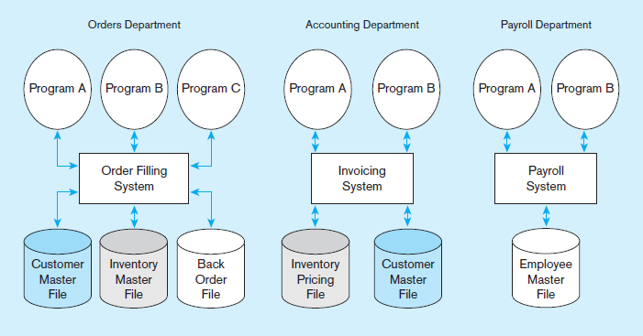
Figure 1-2 Old File Processing Systems at Pine Valley Furniture Company
Notes:
Program-data dependence: The Customer Master File is used in the Order Filling System and the Invoicing System. Suppose it is decided to change the customer address field length in the records in this file from 30 to 40 characters. The file descriptions in each program that are affected (up to five programs) would have to be modified. It is often difficult to even locate all programs affected by such changes.
Duplication of data: Note two different files containing inventory data. One is used for order filling and the other for invoicing. This duplication is wasteful because it requires additional storage space and increased effort to keep all files up to date. Data formats may be inconsistent, data values may not agree, or both. Reliable metadata is very difficult to establish in file processing systems.
The Pine Valley Furniture (PVF) company will be an ongoing case in this textbook. You will become very familiar with PVF over time.

Slide 16
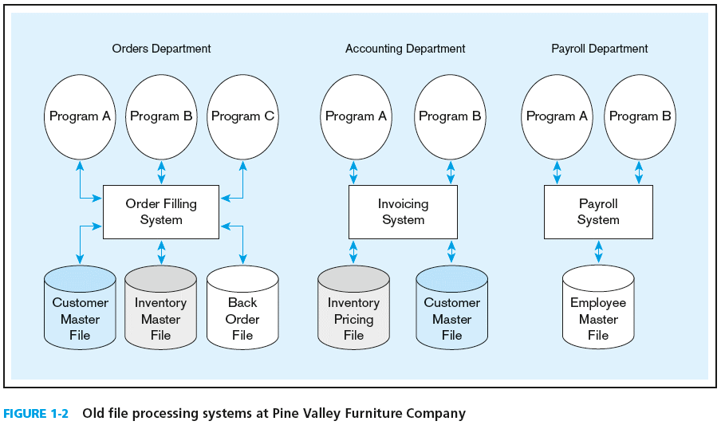
Duplicate Data
Notes:
Data Duplication
What is the issue with this picture?
Order Dept needs 3 files: customer, inventory, and back order
Acct dept needs inventory pricing and customer
Payroll needs employee file
What is the problem?

Slide 17
Problems with Data Redundancy
Waste of space to have duplicate data
Causes more maintenance headaches
The biggest problem:
Data changes in one file could cause inconsistencies
Compromises in data integrity
Notes:
How much space was in Apolo 11. 255k?

Slide 18
SOLUTION: The DATABASE Approach
Central repository of shared data
Data is managed by a controlling agent
Stored in a standardized, convenient form
Requires a Database Management System (DBMS)
Notes:
It solves most of the problems with file-based approach.
Central repository of shared data – many applications can connect to the same database
Data is managed by a controlling agent -> database agent controls the properties of database
Stored in a standardized, convenient form – in the forms of tables and columns

Slide 19
Database Management System
A software system that is used to create, maintain, and provide controlled access to user databases
Order Filing
System
Central database
Contains employee,
order, inventory,
pricing, and
customer data
Invoicing
System
DBMS
Payroll
System
DBMS manages data resources like an operating system manages hardware resources
Notes:
A software system that is used to create, maintain, and provide controlled access to user databases

Slide 20
Database Management System
What are the advantages of the Database Approach?
Notes:
Take a few minutes and write down 3 advantages of the database approach.

Slide 21
Advantages of the Database Approach
Program-data independence
Planned data redundancy
Improved data consistency
Improved data sharing
Increased application development productivity
Enforcement of standards
Improved data quality
Improved data accessibility and responsiveness
Reduced program maintenance
Improved decision support

Slide 22
Costs and Risks of the Database Approach
New, specialized personnel
Installation and management cost and complexity
Conversion costs
Need for explicit backup and recovery
Organizational conflict
Notes:
New, specialized personnel – need a DBA to perform the tasks
Installation and management cost and complexity
Conversion costs – not free
Need for explicit backup and recovery
Organizational conflict

Slide 23
Elements of the Database Approach
Data models
Graphical system capturing nature and relationship of data
Enterprise Data Model–high-level entities and relationships for the organization
Project Data Model–more detailed view, matching data structure in database or data warehouse
Entities
Noun form describing a person, place, object, event, or concept
Composed of attributes
Relationships
Between entities
Usually one-to-many (1:M) or many-to-many (M:N)

Slide 24
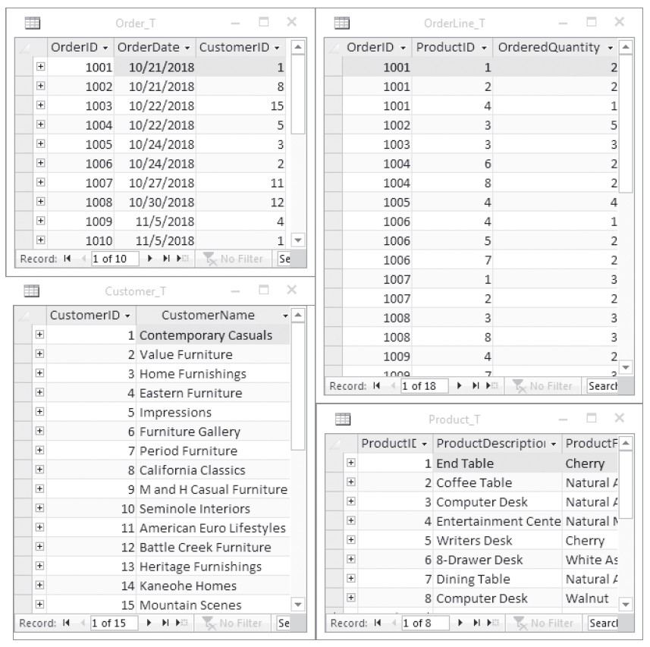
The Database Approach
Relational Databases
Database technology involving tables (relations) representing entities and primary/foreign keys representing relationships
Notes:
The database management system (DBMS) is a software system that is used to create, maintain, and provide controlled access to user databases.
Most current DBMSs are in the form of relational databases, which represent data as a collection of tables in which all data relationships are represented by common values in related tables. We will explore relational databases in detail throughout this course.
Note that because all the data is shared in a central database, there is no longer the need for separate systems and programs to maintain their own copy of the data. This reduces duplication and increases integrity.

Slide 25
Enterprise Data Model
First step in database development
Specifies scope and general content
Overall picture of organizational data at high level of abstraction
Entity-relationship diagram
Descriptions of entity types
Relationships between entities
Business rules
Notes:
The very first step in the database project is to design an Enterprise data model.
First step in database development
Specifies scope and general content – are modeling a subsection of the business or the whole business. Whats’ in scope whats’ out of scope
Overall picture of organizational data at high level of abstraction – at this point no details are necessary, just high leverls
Entity-relationship diagram – how the entities related to one another
Descriptions of entity types – the description and high level business rules
Relationships between entities
Business rules

Slide 26
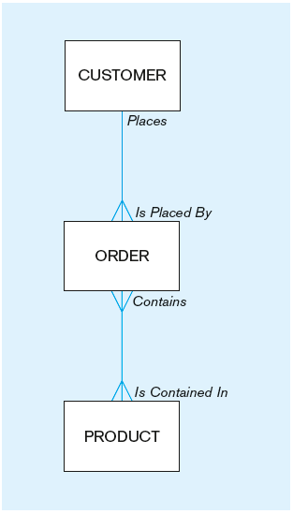
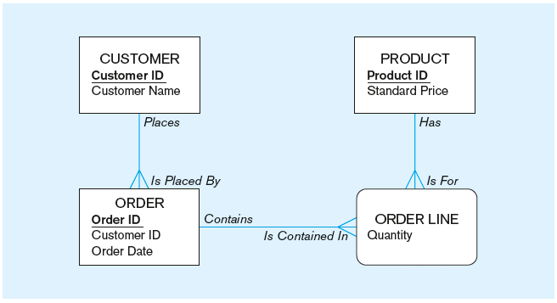
Figure 1-3 Comparison of enterprise and project level data models
Segment of an enterprise data model
Segment of a project-level data model
Notes:
Rectangular shape – entities
Lines ( in blue) – relationships
Verbs indicating the relationships. Notation
What is the difference between these two data models, the enterprise vs project level?
Comparison of enterprise and project level data models

Slide 27
One customer may place many orders, but each order is placed by a single customer
→ One-to-many relationship
Notes:
One to many relationship circled between customer and order

Slide 28
One order has many order lines; each order line is associated with a single order
→ One-to-many relationship

Slide 29
One product can be in many order lines, each order line refers to a single product
→ One-to-many relationship
Notes:
One to many between order line and product

Slide 30
Therefore, one order involves many products and one product is involved in many orders
→ Many-to-many relationship
Notes:
Many to many relationship
Curly square here means it is an associative entity. We will cover different types of entities later.

Slide 31
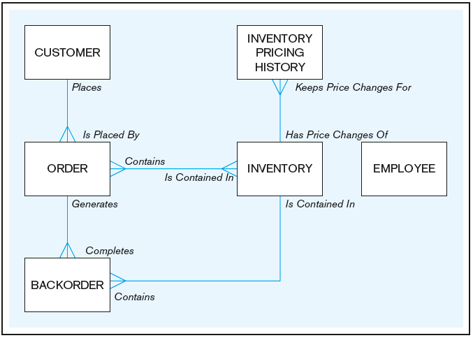

Example of Enterprise Data model
Notes:
Example of an enterprise model !!!!
Image this is an online retailer that sells books.

Slide 32
Problem 1
1. For each of the following pairs of related entities, indicate
whether (under typical circumstances) there is a one-to -many
or a many-to-many relationship. Then, using the shorthand notation introduced in the text, draw a diagram
for each of the relationships.
STUDENT and COURSE (students register for courses)
BOOK and BOOK COPY (books have copies)
COURSE and SECTION (courses have sections)
SECTION and ROOM (sections are scheduled in rooms)
INSTRUCTOR and COURSE

Slide 33
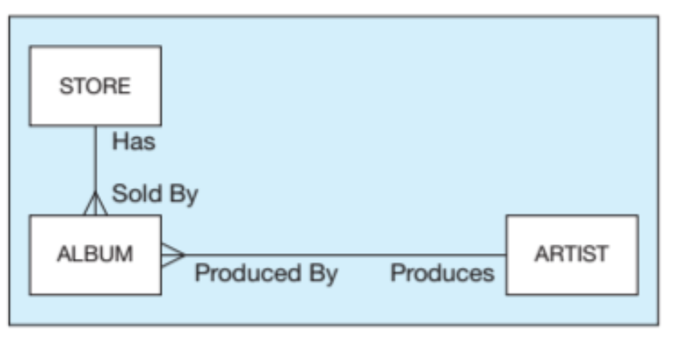
Problem 2
Figure below shows an enterprise data model for a music store.
What is the relationship between Album and Store (one-to-one, many-to-many, or one-to-many)?
What is the relationship between Artist and Album? c. Do you think there should be a relationship between Artist and Store? Describe at least one possible scenario that could justify such a relationship.
Notes:
one-to-many
one-to-many
If one is added, it is essential that the designer carefully define what the meaning of the new relationship is. It could, for example, mean that the store intends to carry all albums by a specific artist

